Slide 1
OC HCP Journeys
Project Introduction
April 2021

Slide 2






Omnichannel HCP Journeys are critical now to reach competitive SOV and differentiate long term
Why ?
The traditional methods of engaging with HCPs no longer meets physician needs, and Galapagos aims to engage differently.
What is the Value?
HCP Journeys are an effective way to align the sales, marketing, and medical functions effectively.
Galapagos is working in a highly competitive landscape, and reaching competitive SOV is key
Why now?
Omnichannel journeys have potential to differentiate by delivering a personalised HCP experience in the first 6 month post launch which are decisive
Designing these journeys at the period of ISP will provide long term benefit to the countries
Clear and consistent HCP Journeys are the foundation of more advanced marketing techniques and efficiencies
McKinsey - From product to customer experience: The new way to launch in pharma
McKinsey- Marketing’s Holy Grail: Personalization at Scale

Slide 3

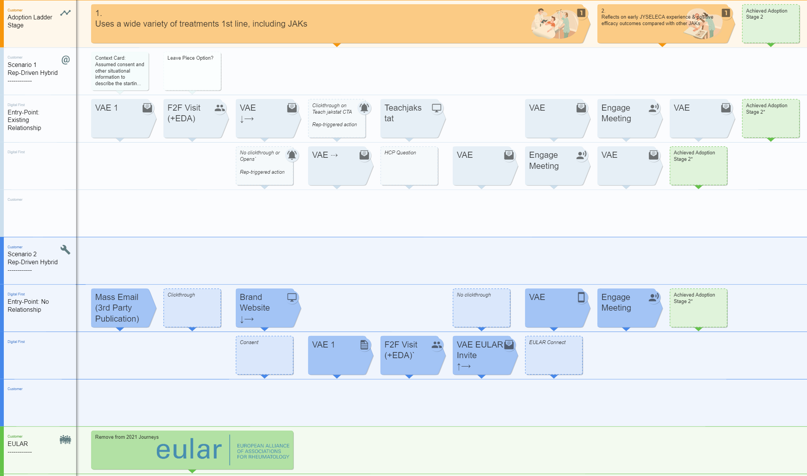
What is the HCP Journeys Project?
A cross functional team is now making strategy a reality, by creating HCP Journeys that bring together existing content, OC channels and research…
…into maps to guide the rapid movement of HCPs through stages in the adoption ladder.
Illustrative example

Slide 4
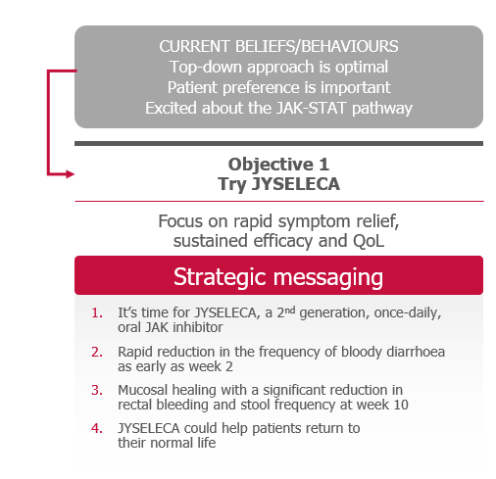
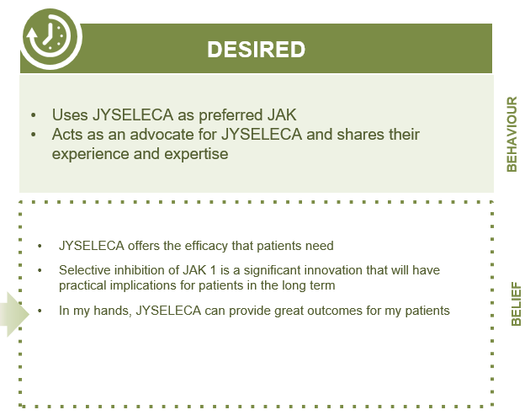
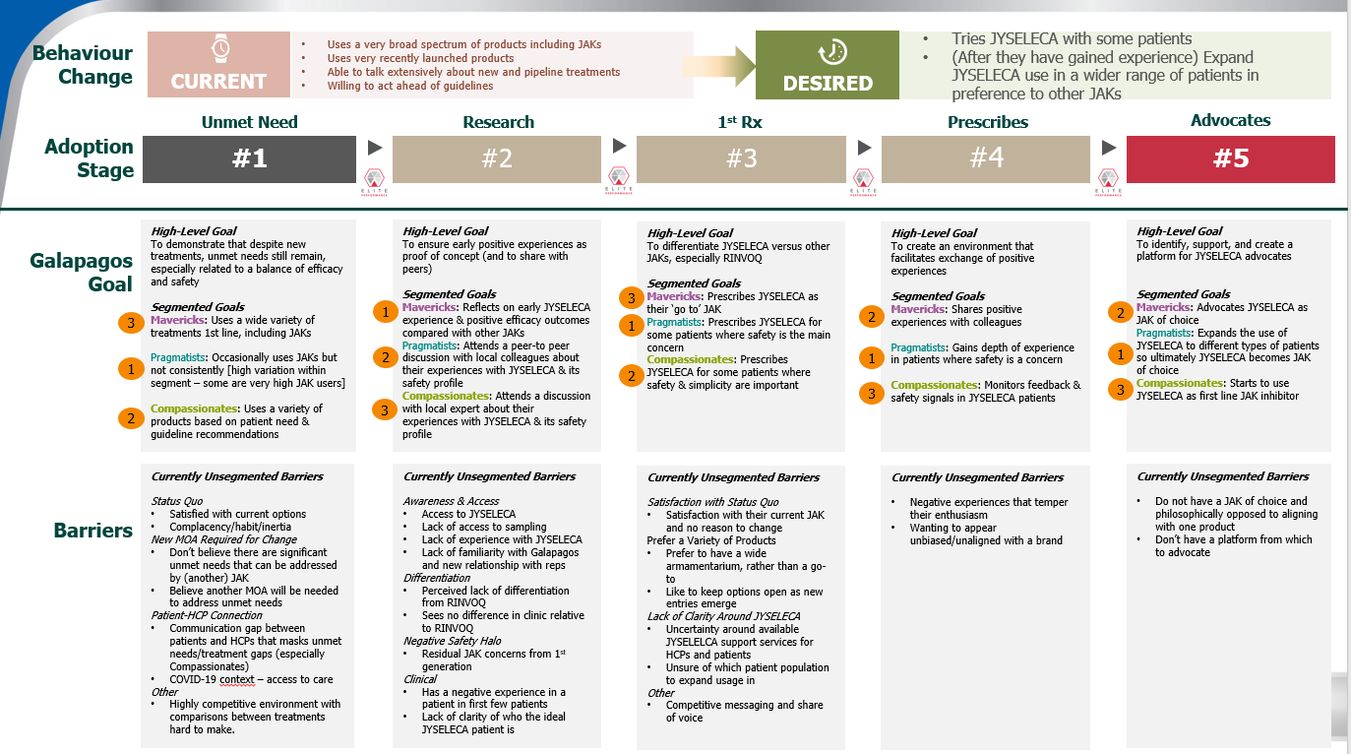
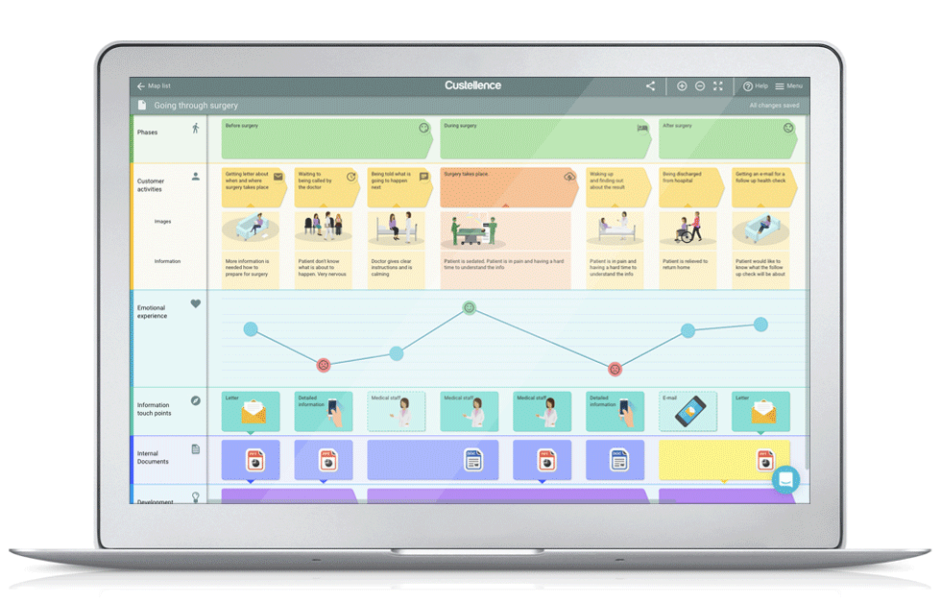







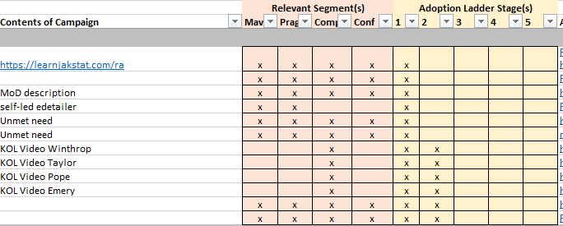

The approach builds upon a foundation of Jyseleca research, segmentation and content.
Leverage existing material
Deploy unique methodology across indications
Develop the Journeys
Research | Segmentation Channels | Content
The execution-focused mapping of the touchpoints with a HCP.
Adoption Ladder consolidation & consistent format
International Versions
IBD Segmentation
RA Segmentation
International cross functional teamwork
Content alignment to segmentation and adoption ladder stage
Country specific versions
International cross functional teamwork
International cross functional teamwork
Not In Scope : Rep execution training, Journey orchestration pilots

Slide 5
How we are making this a reality
To reduce market workloads and to maximise outputs, we are working via a localisation model, with heavy support to markets between engagements.
March |  |  | April | April |  |  | May | May |  |  | June
15th | 22nd | 29th | 5th | 12th | 19th | 26th | 3rd | 10th | 17th | 24th | 31st | 7th | 14th | 21st
Leverage existing Strategy
Creation of consolidated, granular Adoption Ladder, to bring clarity to the brand strategy, research and segmentation
International Journey Creation
Creation of a set of scenario-driven customer journeys, to act as the template for localisation
Journey Localisation
Supported localisation of international Journeys
Brand - RA
Brand - IBD
“Light touch” market engagements
CI&E - OC
CI&E - SFE
CRM & Technology
Market Research
Partner Agencies
RA International Journeys being developed
IBD International Journeys soon to be developed

Slide 6

This work would normally require 3 weeks, we offer to streamline to 3 workshops across 2 months
The engagements are spread over 3-4 weeks, and respect local agendas
First Engagement
during MOC meeting (1hr)
Gather market buy-in for project and define joint objectives
Workshop 1 (2hr)
Local adoption ladder finalisation,
Local HCP journeys initiation using International journeys
Workshop 3 (2hr)
HCP journey finalisation.
Local Signoff
International support
International support
International support
International support
Offline Pre-Work (1-3 weeks)
Gathering of local research, segmentation, strategy, context, content and channel preferences.
Workshop 2 (2hr)
Local HCP Journey iteration

Slide 7





The next steps in each country
RA
Finalise the international HCP Journeys, ready for localisation
May
June
IBD
Begin the creation of the international HCP Journeys, ready for localisation
RA: Gather local strategy, and begin the localisation of the HCP Journeys
June
RA/IBD: Schedule local workshops and prepare strategic journey inputs
June
Expected workshop dates
TBD
RA: Schedule local workshops and prepare strategic journey inputs
TBD
RA: Schedule local workshops and prepare strategic journey inputs
IBD: No activity until September, for optimal market timing
September
TBD
RA: Schedule local workshops and prepare strategic journey inputs
BNL BE / AU etc
RA/IBD: Schedule project introductions and gather local content / requirements
TBD

Slide 8
Appendix

Slide 9







This project involves an International group
The core international team is comprised of the following cross-functional team members:
The HQ Team
The External Advisors
Eeva Salminen/Patrick Ludlow – Brand
DDB – Content
Secil Basoglu – Omnichannel
Veeva Business Consulting – Project Orchestration
Camille Hoffman – Market Research
The Extended Team
Additional support & insights provided through the project by Medical, Market Access, & Launch Excellence
Clare Blakey – Training
Johan Siverstrand – Sales Force Effectiveness

Slide 10
What the HCP Journey could look like
Structured by Adoption Ladder Stage
Entry Point Scenarios
Different entry-points (e.g. Existing Relationship, Digital-only) necessitate specified journeys
Content Boxes
Each box represents channels, selected and organized with the goal of moving an HCP up the adoption ladder.
DRAFT

Slide 11

RACI Matrix Local
Task | Digital Board (HQ) | OC/ CI&E Lead (Local) | Brand Lead (Local) | Medical (Local) | Compliance (Local) | Pharmacovigilance (Local)
Digital Content Creation for specific Brand and every step of the journey | I | C | RA | I | I | I
HCP Journey design | C | RA | C | C | C | I
Journey implementation | I | RA | I | I | I | I
Journey Follow-up and optimization | I | RA | I | I | I | I
HCP Registration process design and implementation | C | RA | I | I | I | I

Slide 12



Journeys are an integral step in Jyseleca Sales & Marketing
Strategy & Planning
Engagement Preparation
Execution
Measurement
START
Standup core channels
FINISH
Create Adoption Ladder
Define go to market strategy
Office led execution
Marketing, Medical, OC
Set brand strategy
Define customer engagement model
Measure impact
Analyze next best action
Define HCP attitudinal segments
Define HCP (touchpoint) journeys
Design territories and allocate reps
Cross team alignment
Create segmented content
To be Validated
Sales coaching
Field Manager
Set MCCP
Set incentive comp plan
Track performance
Field Rep
Define activity plan
Set up HCP meetings
Pre-call planning
Prepare content
Rep led execution
Capture in-call insight
Log interaction
Measure ladder of adoption
Trigger follow on action
Track progress
HCP
HCP accepts
HCP triggered
HCP response
Project output
Updated during project
Project input

Slide 13
HCP Journey Mapping is a priority for us…
Local market quotes?
“To meet our customer at the relevant spot at the relevant time with the relevant message.”

Slide 14
How to use HCP Journey Maps in Business?
1.Rule Based
2.Predictive
3.Cognitive
The use of different channels with ensuring consistency on channels & media
Utilizing all channels & media to deliver a compelling and coherent journey experience
Channels and media deliver the right content to the right person in the right place at the right time.
Ensure the key touchpoints are defined so data connection can be valid.
Execute journey boosters to ‘pilot’ journeys – building blocks for NBA engine
AI understands customer intent and manages the interaction
Research | Segmentation Channels | Content |
Journey Maps
Operationalize journey execution at scale
The execution-focused mapping of the touchpoints with a HCP.
illustrative versions
executable versions
automated versions
Move from messages to conversations with analytics.
Shift from targeting to near real time decision making.
The decision directs the experience.

Slide 15
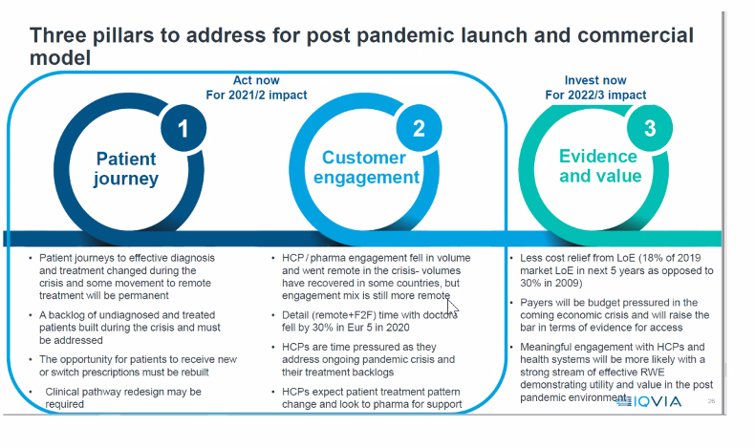
Add to value slide?

Slide 16
What is the HCP Journeys Project?
Jyseleca has a foundation of strategic planning related to customer engagement, launch activity, detailed segmentation and market research.
A cross functional team is now making the strategy a reality, by converting these foundations into HCP Journeys that are practical and actionable at the local level, to secure competitive differentiation and SOV.
The Outcome
Clear Customer Journeys, for RA & IBD key markets, leveraging existing content and channels, that are designed to quickly move HCPs through stages in the adoption ladder.
Next slide ‘what is an hcp journey’, and how it fits into everyday life

